Slide 1

Quantum entanglement
Tom gaillard

Slide 2
Summary
Trigger Article
What is quantum computing?
Quantum Entanglement (QE)
Quantum Computing application
Activity

Slide 3
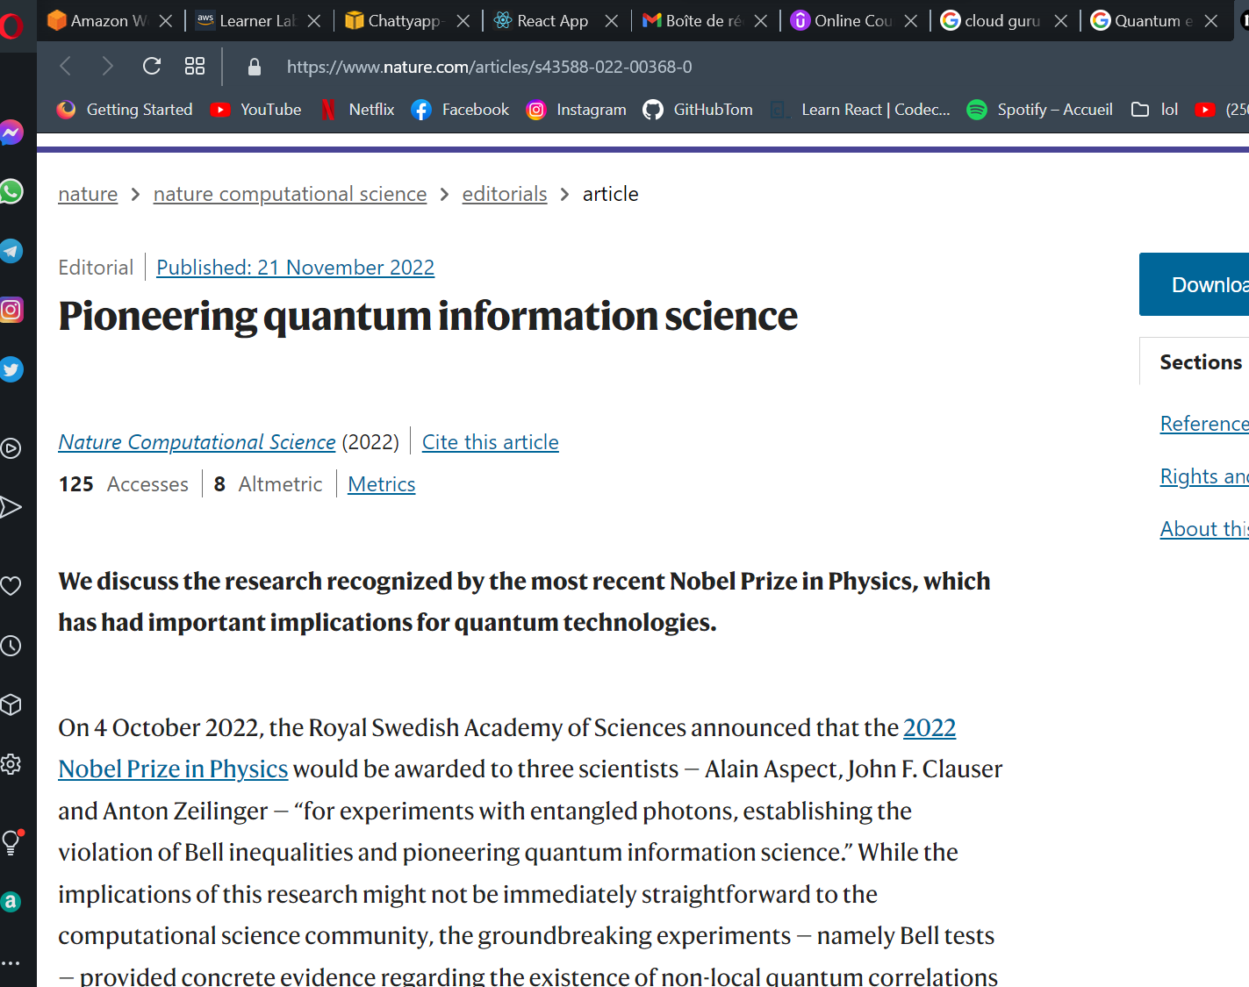
Trigger Article
Alain Aspect
John F. Clauser
Anton Zeilinger

Slide 4
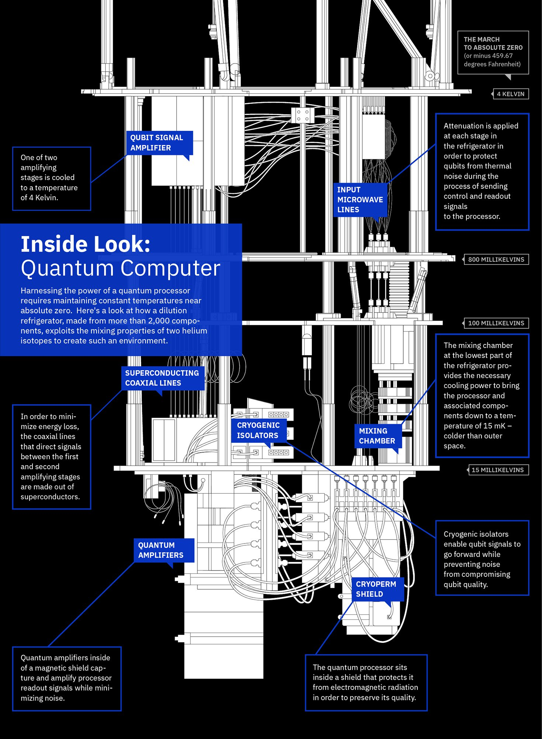
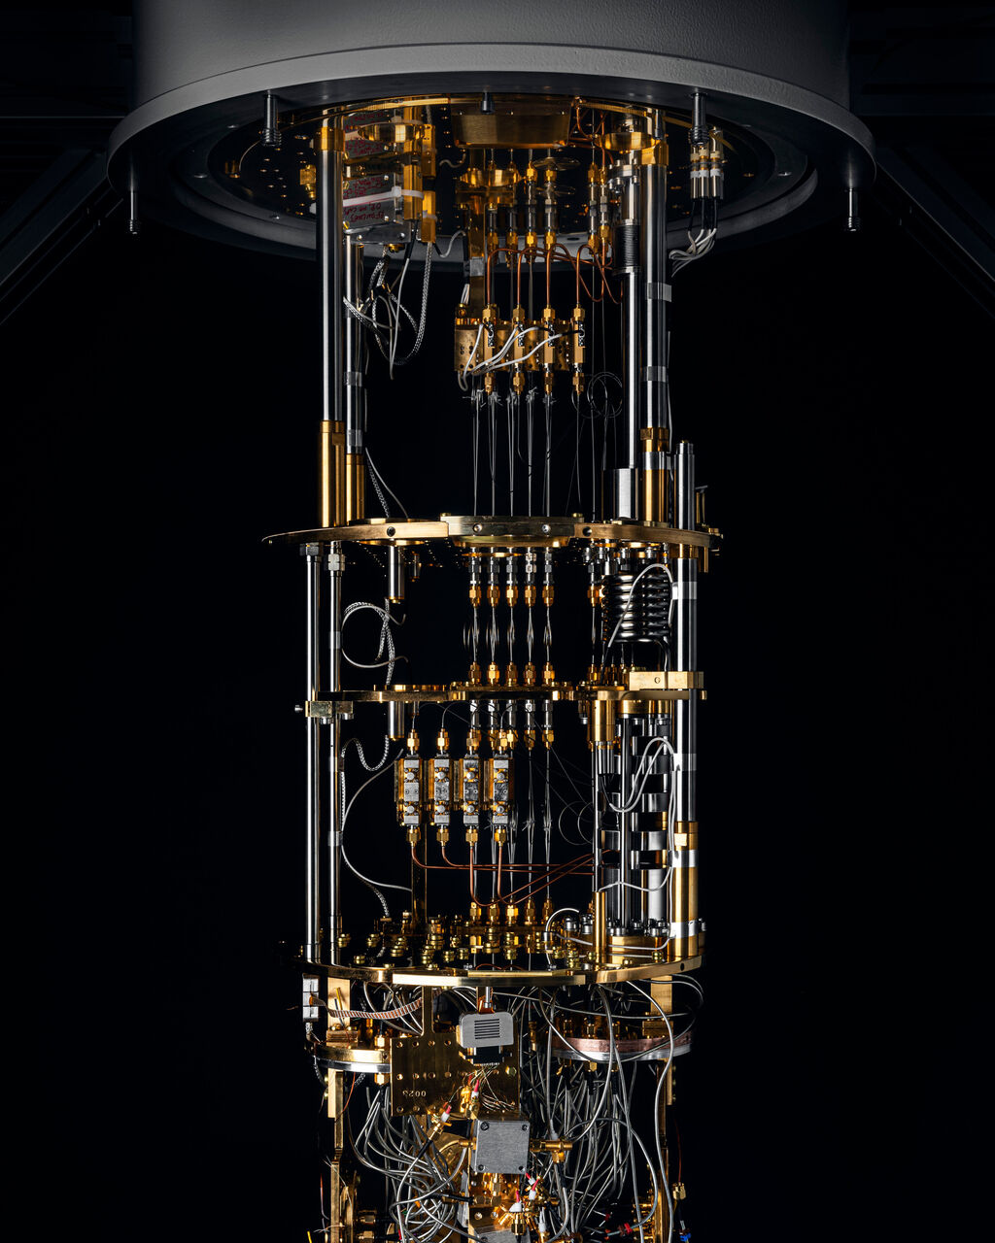
What is quantum computing?
Technology that harness the law of quantum mechanics, such as interference, superposition and entanglement to solve problems too complex for binary computers
It uses subatomic particles and Quantum bits (Qubits) allow these particles to be in more than 1 state at once

Slide 5


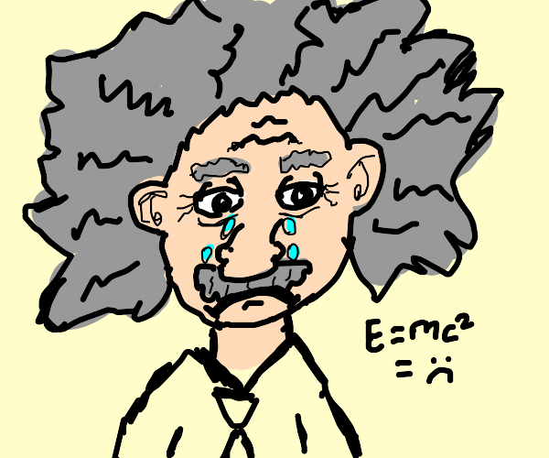
Quantum Entanglement
At least 2 particles that are linked to one another and a change introduced in one of the two will be instantaneously reflected in the other one.

Slide 6
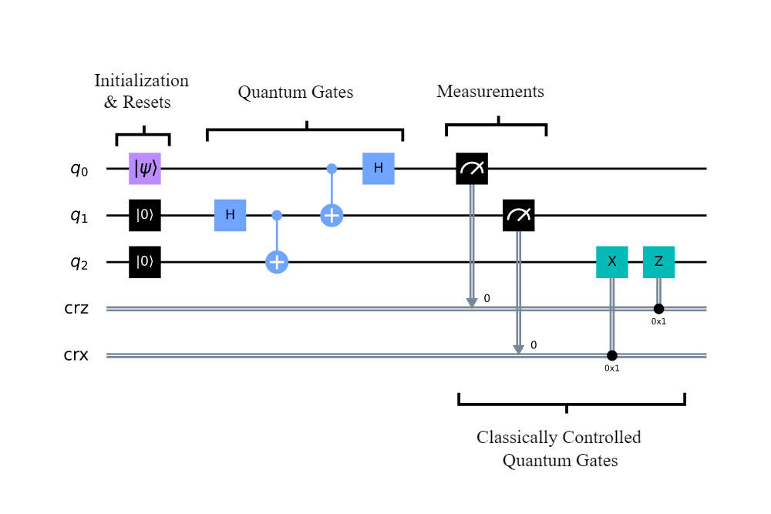
Quantum computing application
Artificial intelligence
Better batteries
Cleaner fertilization
Cybersecurity
Drug development
Electronic materials discovery
Financial modeling
Solar capture
Traffic optimization
Weather forecasting and climate change
Cryptography
Molecular simulation

Slide 7

activity

Slide 8
Sources
https://news.cgtn.com/news/2022-05-18/China-launches-its-first-quantum-encrypted-smartphone-1a7SMMT4wtG/index.html#:~:text=In%20more%20than%202%2C000%20kilometers,world%27s%20first%20quantum%20communication%20satellite.
https://www.ibm.com/topics/quantum-computing
https://www.pymnts.com/innovation/2019/quantum-computings-wright-brothers-moment/
https://www.investopedia.com/terms/q/quantum-computing.asp
https://builtin.com/hardware/quantum-computing-applications
https://www.techtarget.com/whatis/definition/superposition
https://www.nature.com/articles/d41586-022-03088-7#:~:text=The%20trio%27s%20experiments%20proved%20that,object%20affects%20another%20far%20away.
https://en.wikipedia.org/wiki/Quantum_entanglement
https://github.com/GaillardTom
https://scienceexchange.caltech.edu/topics/quantum-science-explained/entanglement
https://www.livescience.com/what-is-quantum-entanglement.html
https://www.space.com/31933-quantum-entanglement-action-at-a-distance.html
https://en.wikipedia.org/wiki/Quantum_computing

Slide 9

Thank You
tomgaillard1@gmail.com

